Slide 1

CNTK meets TensorFlow
Natalia An@ Inmeta
Alexander Vaagan @ Inmeta

Slide 2
CNTK and Tensorflow
About deep learning
CNTK basics
Demo CNTK (very simple)
TensorFlow
Demo Tensorflow
CNTK deeper dive
Demo (?)
Summary
Notes:
Har sitt utspring fra Google brain DistBelief v2
Formålet med Tensorflow var å gjøre det enkelt å deploye ML modeller til alt fra mobiltelefoner til store clustere.

Slide 3
Deep Learning : where to use
Speech Recognition
Image Recognition
Machine Translation
…
any task where neural networks are used!

Slide 4
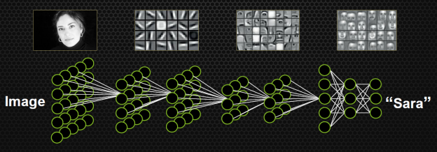
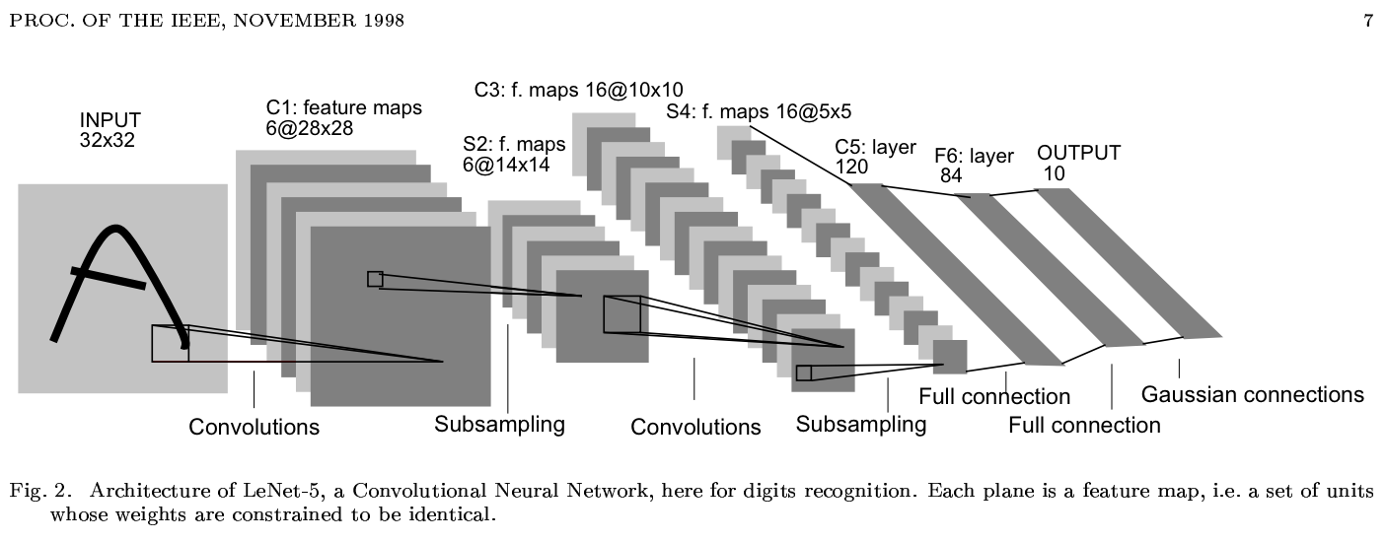
Deep Learning - CNN
Notes:
Mye data
Masse parametere
Mye maskinkraft

Slide 5
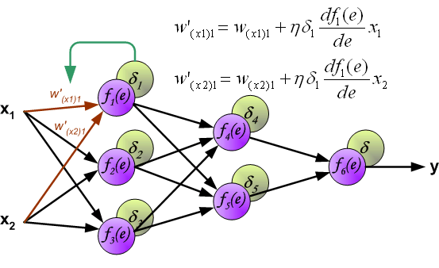
Back propagation
Notes:
Backpropagation
Automatic differentiation

Slide 6
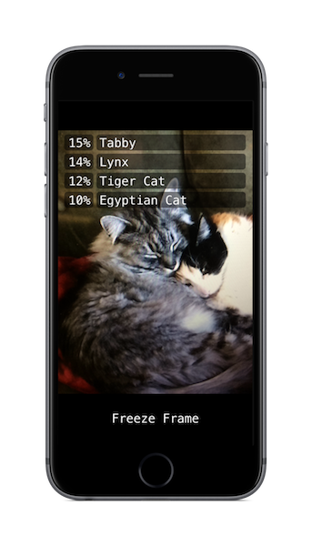

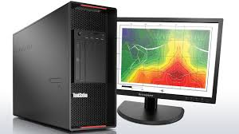
Tensorflow
Formålet var å utvikle et system som gjorde det enkelt å deploye machine learning modeller på ulike hardware konfigurasjoner
Små enheter
Desktop / Server
Very Large Scale!
Notes:
Small scale to Large scale
Open source
Runs on Linux, and Unix. Not Windows!

Slide 7


Tensorflow
Raskt kunne flytte en modell fra Research til produksjon!
Notes:
Har sitt utspring fra Google brain DistBelief v2
Formålet med Tensorflow var å gjøre det enkelt å deploye ML modeller til alt fra mobiltelefoner til store clustere.

Slide 8
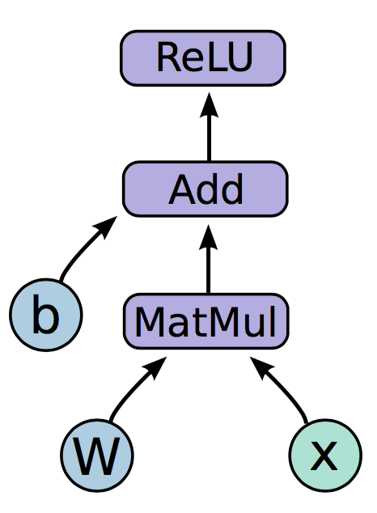
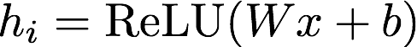
Neural network
Baserer seg på konseptet av en Computational Graph.
Tensors
Notes:
Likner på Theano ved at det tilbyr automatisk derivasjon og optimalisering.
Genererer optimalisert native kode i bagrunnen.
En node i grafen kan enten være data eller en matematisk operasjon
Python, C++, Flere kommer
Forklar Tensor

Slide 9
Natalia CNTK part 1

Slide 10
CNTK : about
CNTK is Microsoft’s toolkit for learning and evaluating deep neural networks
open-source
cross-platform (Linux, Windows, docker, cuDNN5, .Net)
production-ready
scales to multi-GPU/multi-server
available in Azure Data Science VM
available as Docker Container
Notes:
Made by Microsoft Research Lab as parct of speech recognition research 4 years ago. Open-sourced (CodePlex) in early 2015
NVIDIA CUDA® Deep Neural Network library (cuDNN) is a GPU-accelerated library of primitives for deep neural networks. cuDNN provides highly tuned implementations for standard routines such as forward and backward convolution, pooling, normalization, and activation layers. cuDNN is part of the NVIDIA Deep Learning SDK.

Slide 11
…few words about licensing
CNTK license
…free of charge, to any person obtaining a copy of this software and associated documentation files (the "Software"), to deal in the Software without restriction, including without limitation the rights to use, copy, modify, merge, publish, distribute, sublicense, and/or sell copies of the Software
CNTK 1-bit SGD license
general
You may not use the software with other software that has similar functions to, or similar purposes as, CNTK; modify the software to work with other software that has similar functions to, or similar purposes as, CNTK; work around any technical limitations in the software; distribute the software or publish the software for others to copy in source code form; reverse engineer, decompile or disassemble the software, except and only to the extent that applicable law expressly permits, despite this limitation; make copies of the software other than as specified in this agreement or allowed by applicable law, despite this limitation; rent, lease or lend the software.
non-comercial usage
You may not a. alter any copyright, trademark or patent notice in the software; b. use Microsoft’s trademarks in your programs’ names or in a way that suggests your derivative works or modifications come from or are endorsed by Microsoft; c. include the software in malicious, deceptive or unlawful programs;
Notes:
1-bit Stochastic Gradient Descent (1bit-SGD) is an optional component of the Computational Network Toolkit (CNTK) which significantly improves the performance during deep neural network (DNN) training using a single server with multiple GPUs and/or multiple servers with a single or multiple GPUs

Slide 12
CNTK : about
Modularized - separation of
computational networks
execution engine
learning algorithms
model description
data readers
Just like LEGO:
compose nearly any complex computational networks from simple building blocks
some algorithms ready to use (Feed Forward, CNN, RNN, LSTM, Sequence-to-Sequence)

Slide 13
CNTK : how to use
Train
define network in a config file (.bs)
SimpleNetworkBuilder (standard models)
BrainScript Network Builder (custom models)
define training process in a config file (.cntk)
run script for training and testing
cntk configFile=yourConfig.cntk
use trained model
from C++ , C# (and web app in Azure), Python(preview)
new API coming
Evaluate
Deploy
Notes:
Train - Define a network and train it to produce a trained model using training data
Evaluate - Test a trained model to assess its performance using test data
Deploy - Use a trained model, e.g. in your own solution, to classify new instances
There are actually two scripts associated with a CNTK network: a configuration file that controls the
training and test parameters and a network definition language file for constructing the network
September 2016 we plan to release the new CNTK APIs supporting both Python, and C++ bindings, so you will be able to configure your networks, create new nodes, as well as programmatically feed the data from your own Python, and C++ programs

Slide 14
Configure training process
commands
train, test\eval, write, dumpnode …
path to trained model
network details
Network structure
Training criteria
Evaluation metric
reader
How to reade the data
learner
Hyper-parameters of the stochastic-gradient process

Slide 15
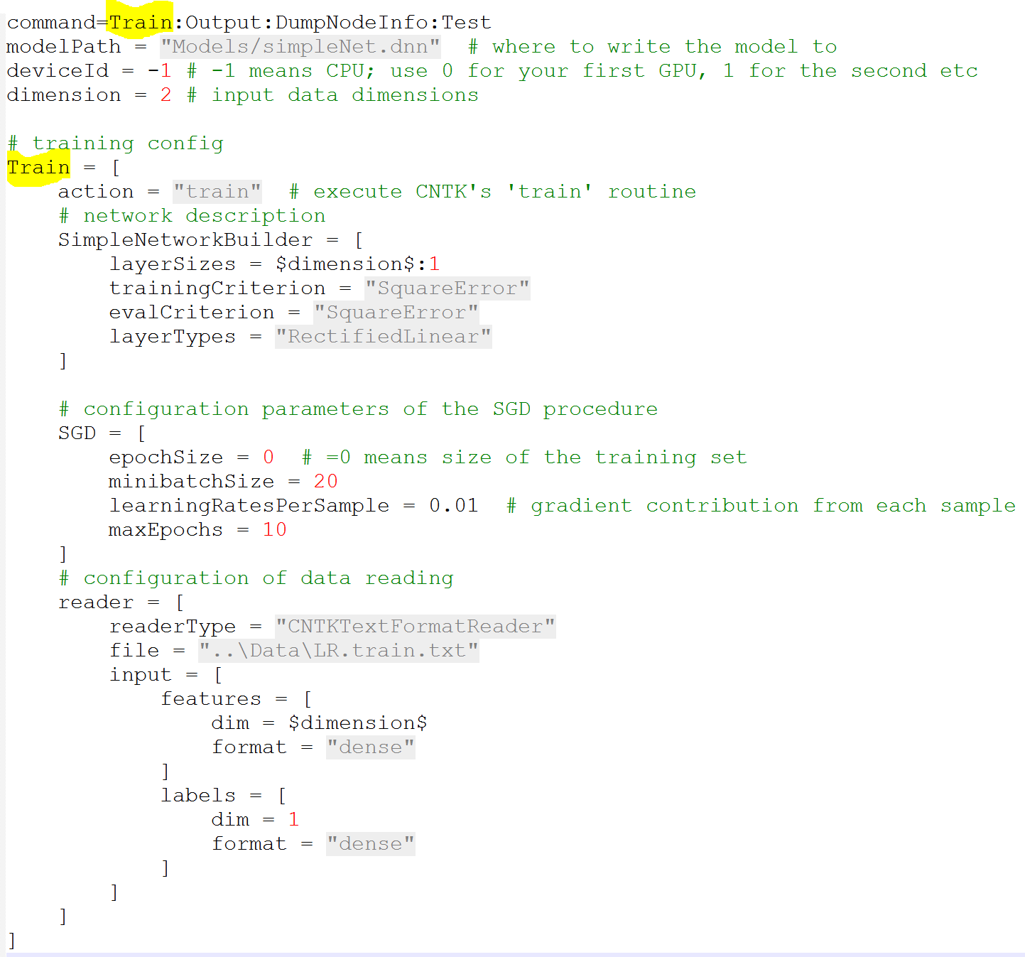
Configure training process

Slide 16
SimpleNetworkBuilder
rnnType (network type)
SIMPLENET, SIMPLERNN, LSTM…
layerSizes (the dimensions of layers)
layerTypes (the type of nonlinear operation in hidden layers)
Sigmoid, Tahn, RectifiedLinear
trainingCriterion
CrossEntropyWithSoftmax, SquareError, CrossEntropy, ClassBasedCrossEntropyWithSoftmax
evalCriterion
applyMeanVarNorm(false), addDropoutNodes(false), recurrentLayer(none)…
Notes:
Allows to use simple standard network types with few lines of configuration. Only a limited set of configuration options is supported.
Include a configuration block of the same name in your training configuration
applyMeanVarNorm - whether to apply mean/variance normalization on the input
addDropoutNodes - If specified to true, a drop-out node will be applied to the input node and the output of every hidden layer
recurrentLayer - specifies the layers that contain self recurrent connections

Slide 17
Configure training process

Slide 18
SGD
epochSize
maxEpochs
minbatchSize (256)
keepCheckPointFiles (false)
dropoutRate (0)
learningRatesPerSample (+ minLearningRatePerSample)
autoAdjust {…} (None, AdjustAfterEpoch)
parallelTrain {…}
gradient control settings
gradient update type (None, AdaGrad, RmsProp)
Notes:
The SGD configuration block controls the behavior of the SGD (Stochastic Gradient Descent) algorithm in CNTK.
epochSize is the number of samples after which specific additional actions are taken, including saving checkpoint, cross-validation, learning rate control, minbatch scaling
minibatchSize is the number of samples processed between model updates
learningRatesPerSample are the learning rates per epoch with which each sample's gradient updates the model
gradUpdateType - gradient update type. Default is none, no special treatment to the gradient

Slide 19
CNTK : usability
stderr
redirect to file
tracelevel
0 (limited), 1 (medium), 2 (verbose)
reader
text, image, HTK
Notes:
All logging information in CNTK is sent to standard error.
The Hidden Markov Model Toolkit (HTK) is a portable toolkit for building and manipulating hidden Markov models. HTK is primarily used for speech recognition research, consists of a set of library modules and tools available in C source form.

Slide 20
CNTK DEMO: very simple Linear Regression

Slide 21
Tensorflow
License – Apache 2.0
Språk – Python / C++
Platform – Linux / Unix only

Slide 22
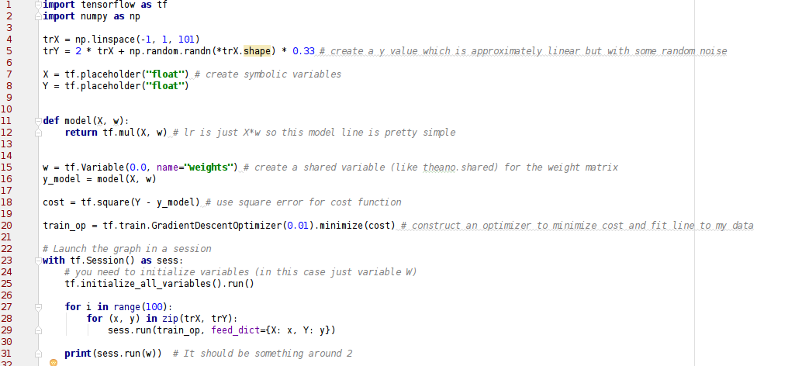
Tensorflow - Linear Regression
Notes:
Likner på Theano ved at det tilbyr automatisk derivasjon og optimalisering.
Genererer optimalisert native kode i bagrunnen.
En node i grafen kan enten være data eller en matematisk operasjon

Slide 23
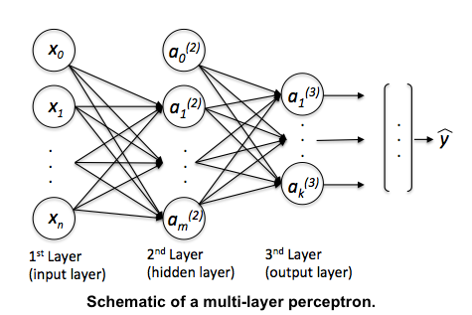
MLP + Softmax

Slide 24
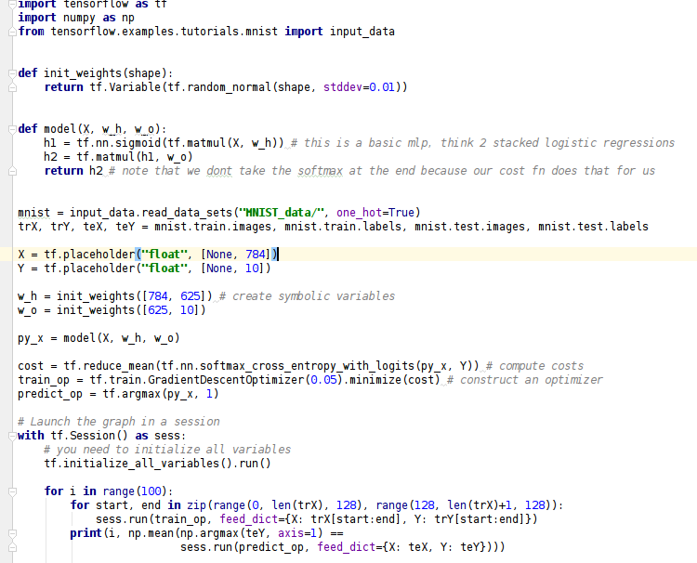
Tensorflow – MLP – 2 Hidden layers
Notes:
Likner på Theano ved at det tilbyr automatisk derivasjon og optimalisering.
Genererer optimalisert native kode i bagrunnen.
En node i grafen kan enten være data eller en matematisk operasjon

Slide 25
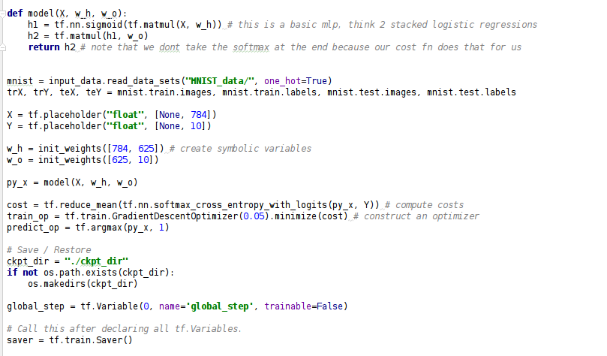
Tensorflow – Resume training
Saver:
Notes:
Saver:
Må defineres etter at modellen er definert. Alt som evt. Defineres etter Saver vil ikke bli lagret

Slide 26
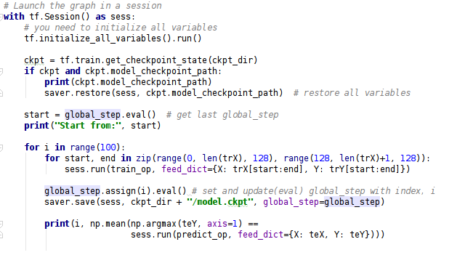
Tensorflow – Resume training
Restore:
Notes:
Saver:
Må defineres etter at modellen er definert. Alt som evt. Defineres etter Saver vil ikke bli lagret

Slide 27
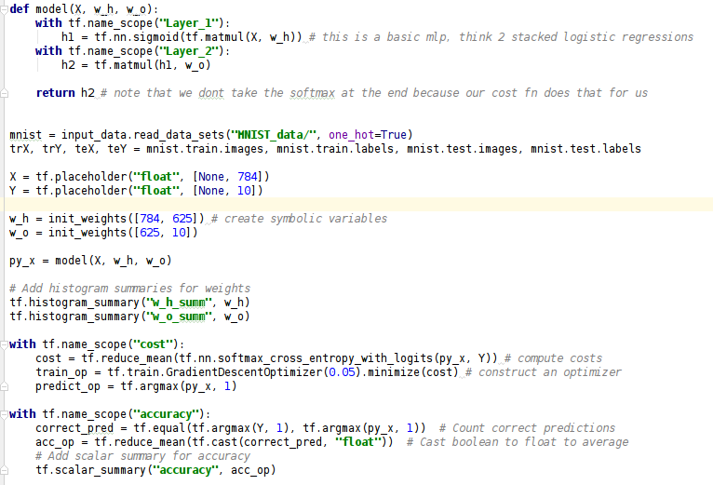
Tensorflow – Logging (Summary)
Notes:
Logging aka. Summary
Definere name scope
Definere historgrammer
Hvordan utvikler costen seg?
Hvordan utvikler accuracy seg?

Slide 28
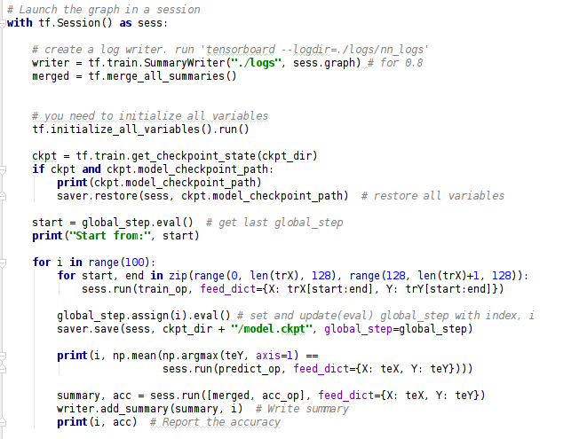
Tensorflow – Logging (Summary)
Notes:
Summmary
Merge all
Thats it
Så hvordan ser loggene ut til slutt?

Slide 29
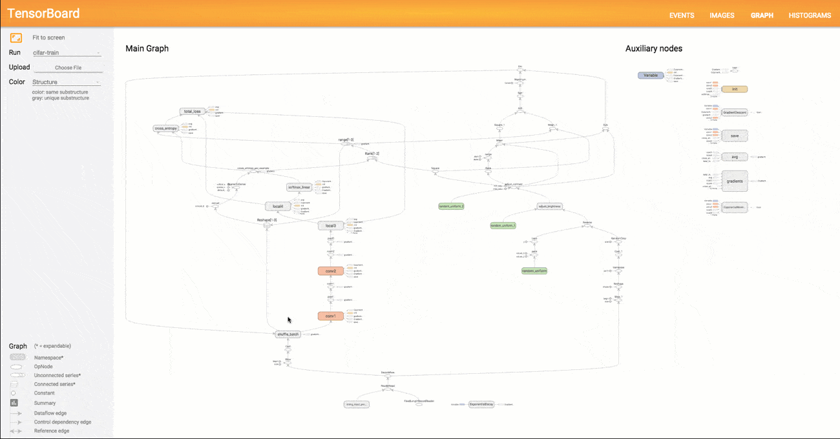
Tensorboard
Notes:
Tensorboad lar deg visualisere treningsgrafen, samt monitorere treningen.

Slide 30
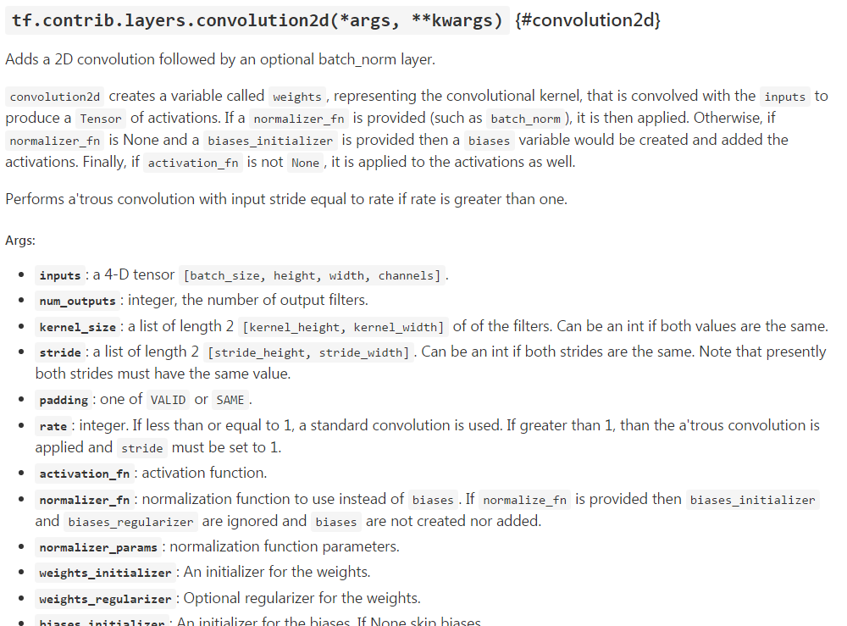
Dokumentasjon – Noen eksempler
Notes:
Har støtte for / ferdig implementasjoner av mange forskjellige lag. Conv, Fully connected, LSTM, Batch.norm.

Slide 31
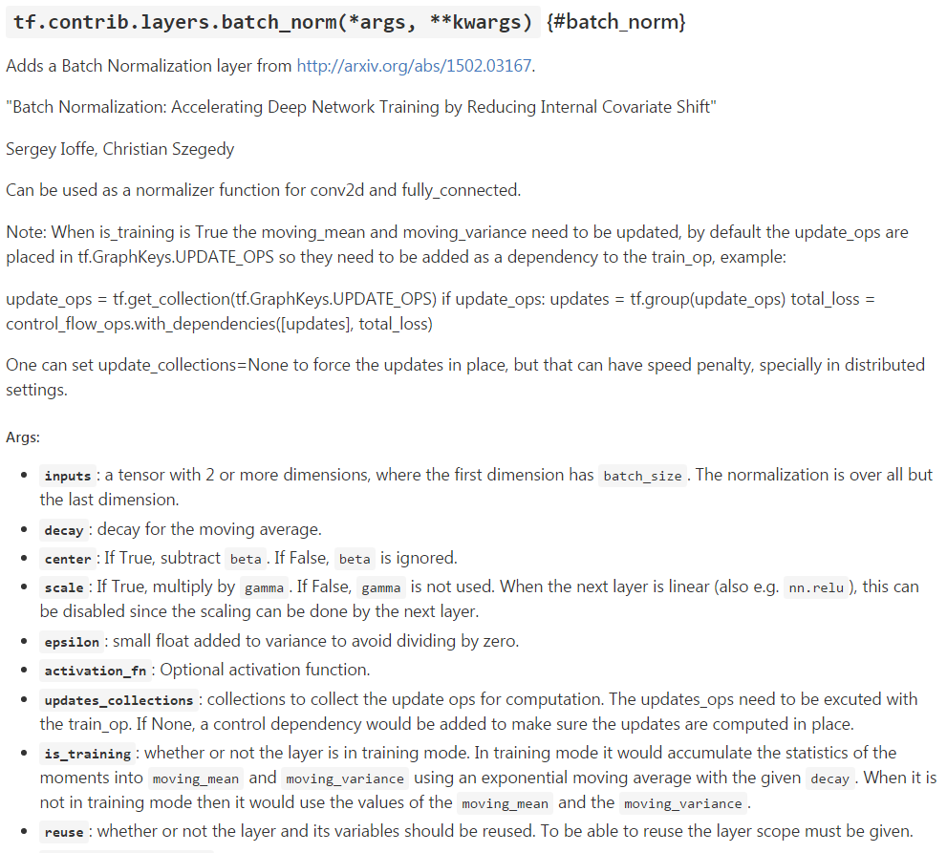
Dokumentasjon – Noen eksempler

Slide 32
Tensorflow DEMO

Slide 33
Natalia CNTK part 2

Slide 34
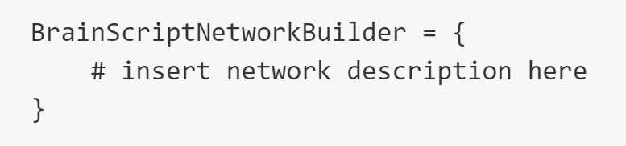
BrainScript
custom network description language
or
include myNetwork.bs

Slide 35
BrainScript Builder basics
variables – tensors and scalars
dynamically typed
«record» r = { x = 13 ; y = 42 } accessed r.x
literals (string, bool, numeric), expressions, conditional expessions
user-defined functions (parameterized expressions)
RFF (x, W, b) = RectifiedLinear (W * x + b)
functions inside functions
can be called recursively
Notes:
bs syntax is aimed to express neural networks in a way that looks like math formulas
All values in the computation network are numeric n-dimensional arrays which we call tensors, and n denotes the tensor rank. matrice is tesor of rank 2. Salar is tensor rank 1 and dimension 1

Slide 36
BrainScript: essentials
Model parameters - any tensor that constitute the learned model
Model function - the actual network formulas
Inputs – features and labels
Training criterion - loss function
Outputs
Evaluation criterion (for performance tracking)
Notes:
A network is primarily described by formulae of how the network's outputs are computed from the inputs.
We call this the model function, which is often defined as an actual function in BrainScript. As part of the model function, the user must declare the model parameters.
Lastly, one must define the network's inputs, and criteria/outputs.

Slide 37
Brain Script: predefined
Activation functions
Sigmoid(), Tanh(), ReLU(), Softmax(), LogSoftmax(), Hardmax()
Loss functions
CrossEntropy, CrossEntropyWithSoftmax, ClassificationError(), etc…
Layers
DenseLayer, ConvolutionalLayer, MaxPoolingLayer, RecurrentLSTMLayer, etc…

Slide 38
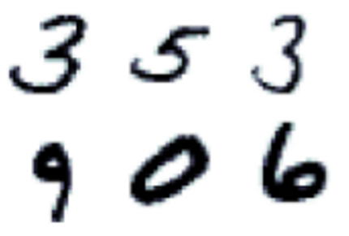
MNIST example
popular image dataset of handwritten digits
training 60.000 examples
test 10.000 examples

Slide 39
CNTK DEMO 2: MNIST with One-Hidden-Layer Neural Network

Slide 40

CNTK: Where to start
https://github.com/Microsoft/CNTK/wiki/Tutorials
… and mandatory kitten picture

Slide 41
Summary

Slide 42
Subjective Feedback
 | CNTK | TensorFlow
Platform | Windows, Linux, CPU\GPU, multi | Linux CPU\GPU, multi
Flexibility | 4 | 5
Documentation / Comminuty | 3 | 5
User treshold | 5 | 3
Usability | 5 | 5

Slide 43

Dokumentasjon:
https://www.tensorflow.org
https://cntk.ai
Hvert til sitt bruk!
Don’t be a fanboy
… and mandatory kitten picture :-P

Slide 44
References and materials
https://github.com/Microsoft/CNTK/
https://github.com/Microsoft/CNTK/wiki/KDD-2016-Tutorial
https://esciencegroup.com/2016/02/08/tensorflow-meets-microsofts-cntk/
http://research.microsoft.com/en-us/um/people/dongyu/CNTK-Tutorial-NIPS2015.pdf

